Slide 1
SpotMe
By Jason ventura

Slide 2
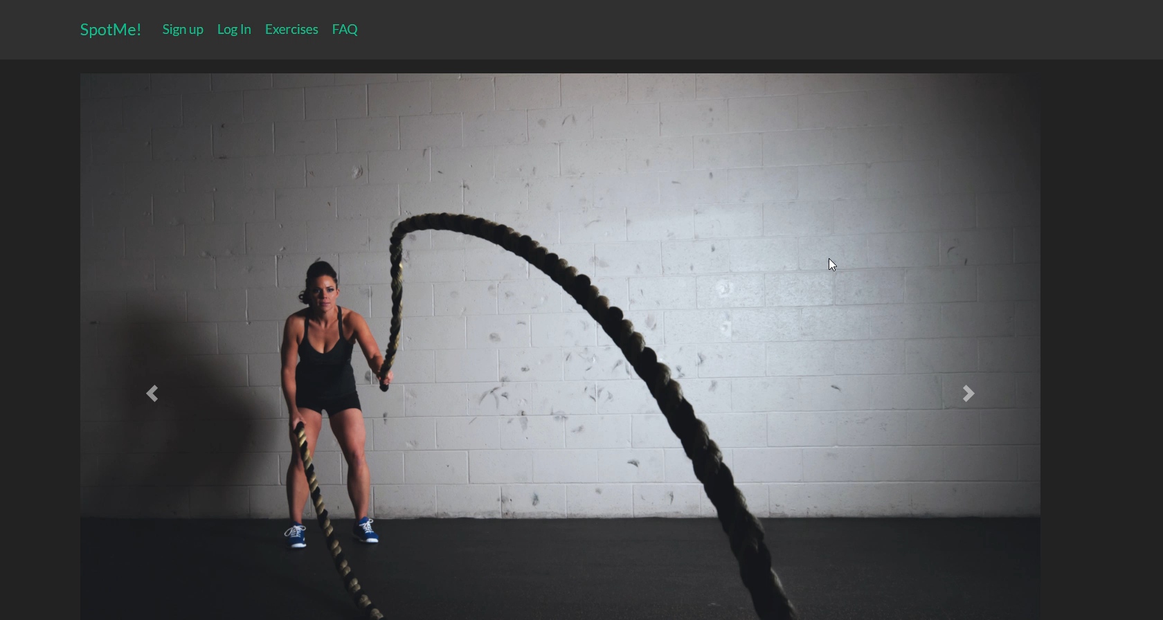
SpotMe Demo

